Slide 1


WINE QUALITY
ANALYSIS & PREDICTIONS
PRESENTED BY:
THE SOMMELIERS

Slide 2
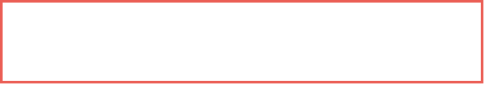

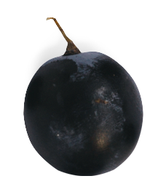







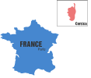




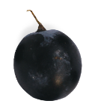
PROJECT
OVERVIEW
Utilize a regression based machine learning model to predict wine quality (points value) based on various features including...
01
COUNTRY
PROVINCE
WINERY
VARIETY
PRICE
DESCRIPTIVE WORDS
Develop interactive dashboard to inform business owners in developing a comprehensive wine inventory.
02
Notes:
notes_title
add_note_to_this_slide

Slide 3
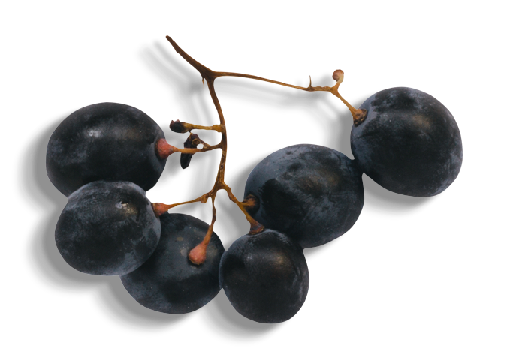
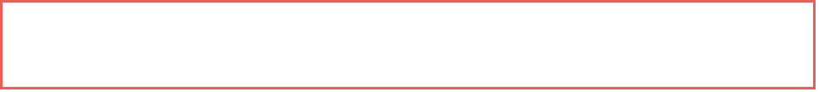


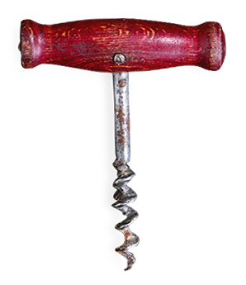
EXPLORATORY
DATA ANALYSIS
01
01
Original dataset included 130,000 entries
02
Data cleaning included: [A] Clean-up specialty characters, [B] Review for null values and removal of columns with many null values (ie: “region_1), [C] Remove unnecessary columns (ie: “taster_twitter_handle”)
03
Cleaned dataset includes: [A] 96,240 entries, [B] 10 columns
04
NLP Parsing Description Field: Identified most common descriptors and assigned as additional features
Notes:
notes_title
add_note_to_this_slide

Slide 4
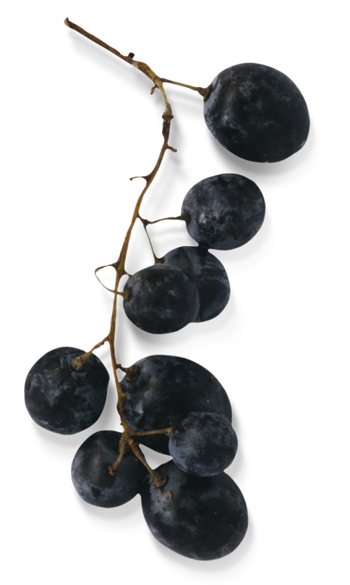
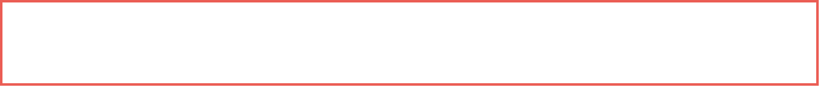
EXPLORATORY
DATA ANALYSIS
01
Original dataset included 130,000 entries
Data cleaning included: [A] Clean-up specialty characters, [B] Review for null values and removal of columns with many null values (ie: “region_1), [C] Remove unnecessary columns (ie: “taster_twitter_handle”)
02
Cleaned dataset includes: [A] 96,240 entries, [B] 10 columns
03
NLP Parsing Description Field: Identified most common descriptors and assigned as additional features
04
Notes:
notes_title
add_note_to_this_slide

Slide 5

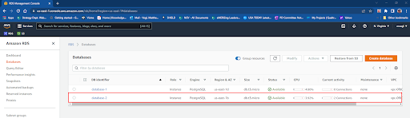

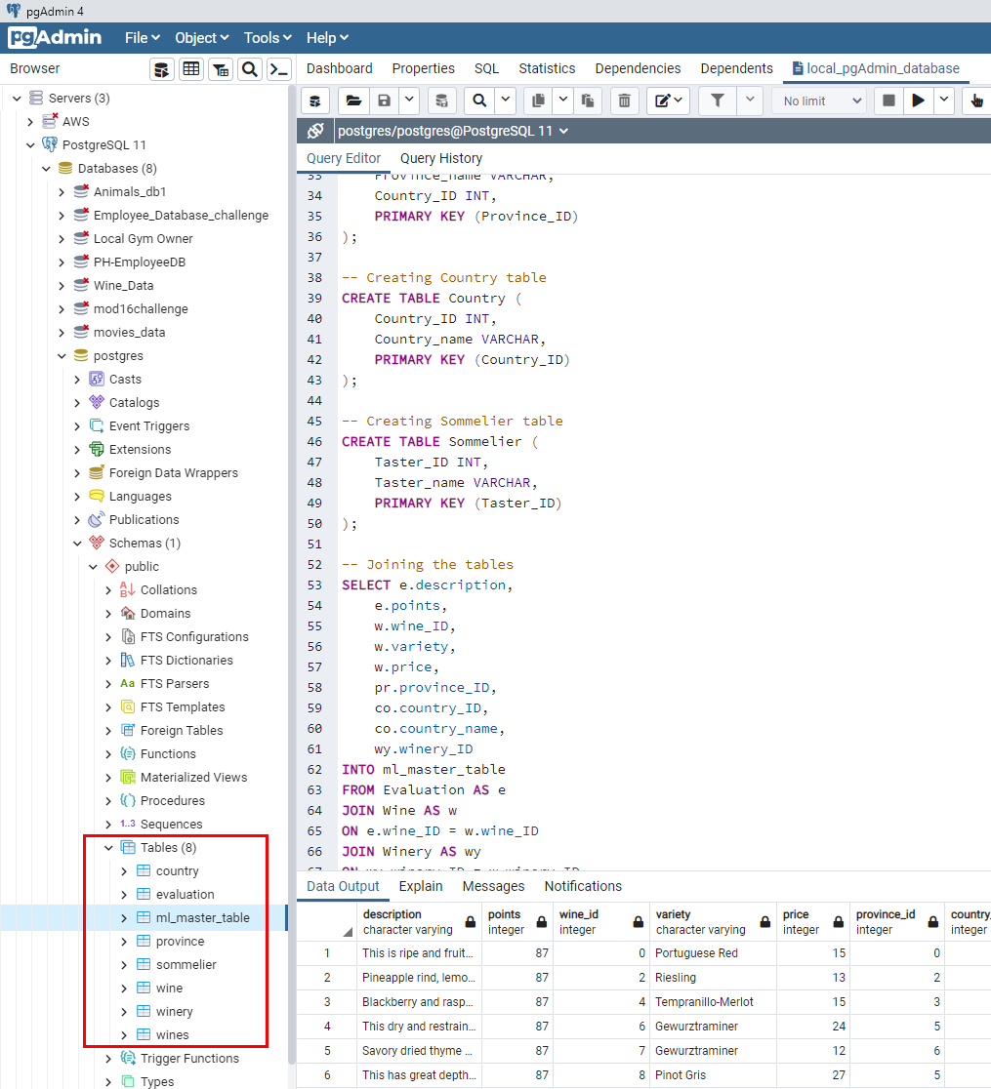
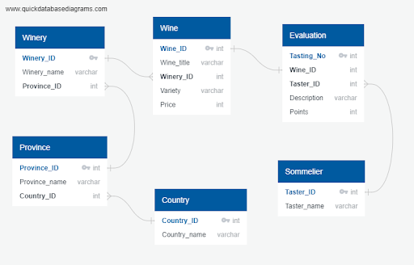

01
DATABASE
03
We began by visually mapping out our database tables connections in an Entity Relationship Diagram (ERD).
Finally, we developed our database schema in pgAdmin and joined all of the tables into a master .CSV file.
Next, we created our RDS database in AWS to host our database in the cloud...then ended up deleting it after it was hacked.
02
Notes:
notes_title
add_note_to_this_slide

Slide 6
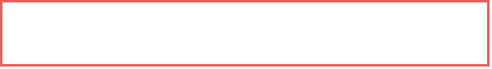
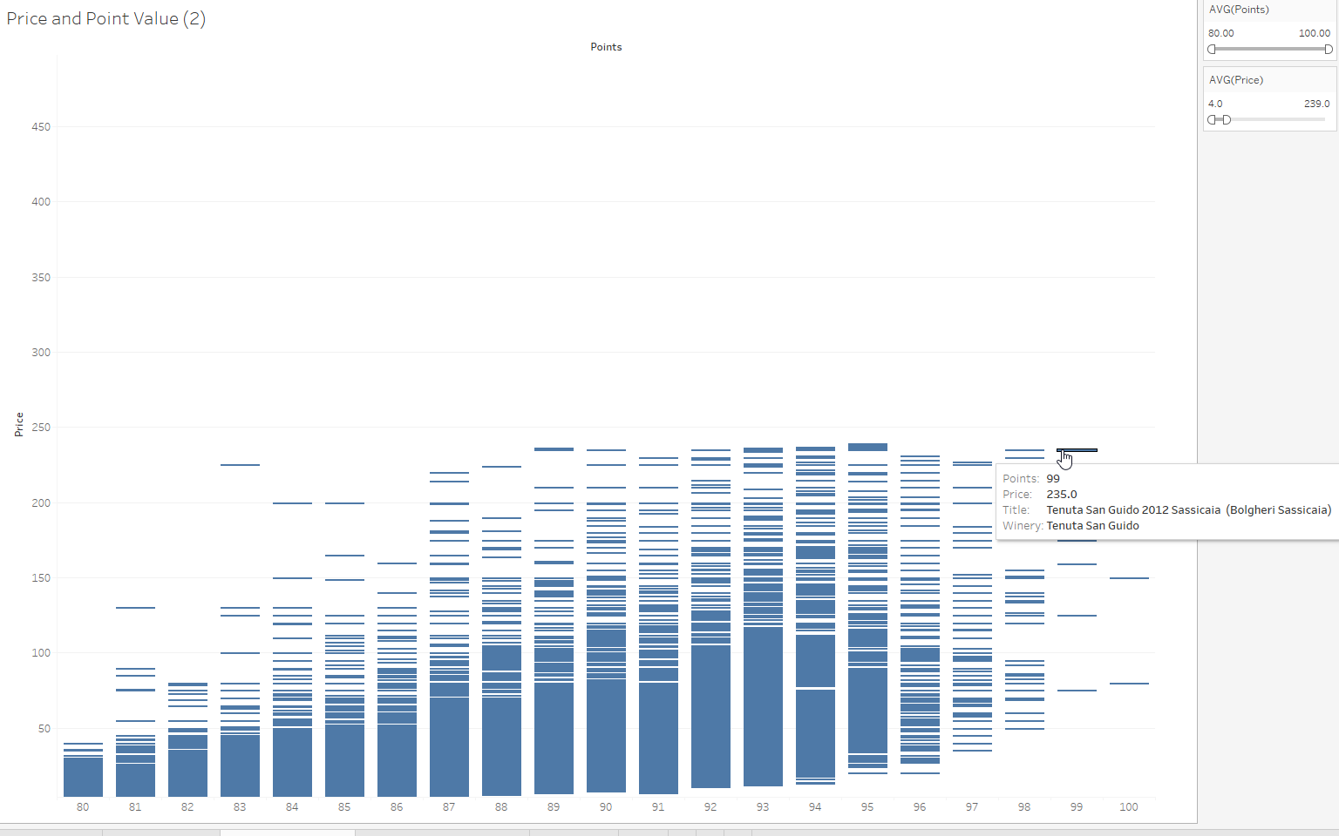

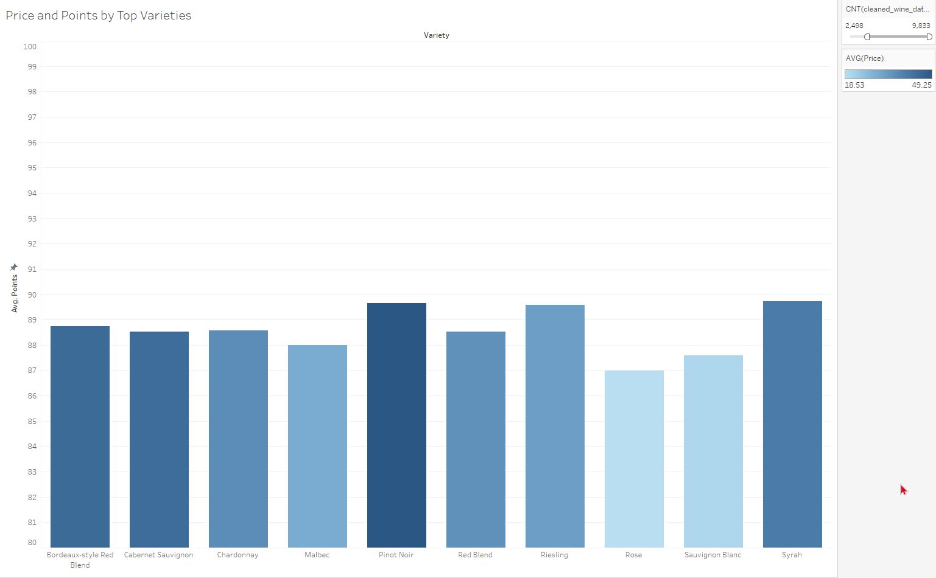
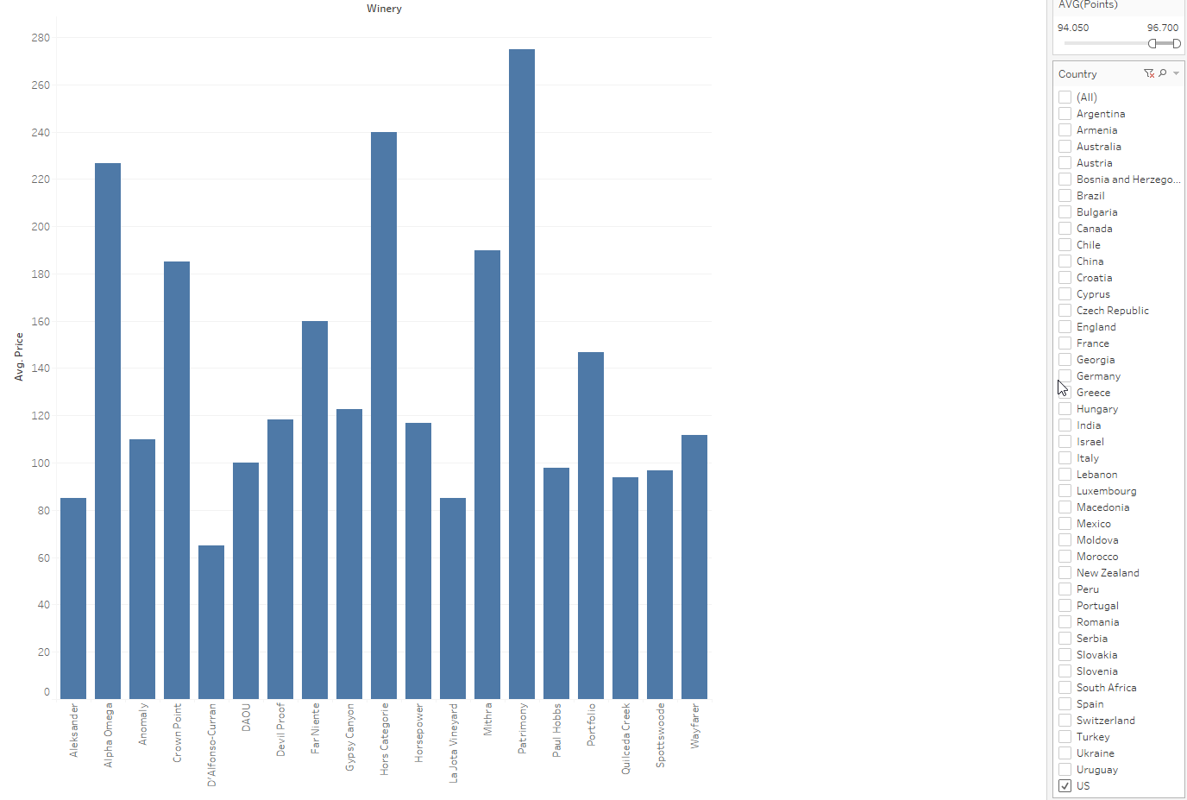
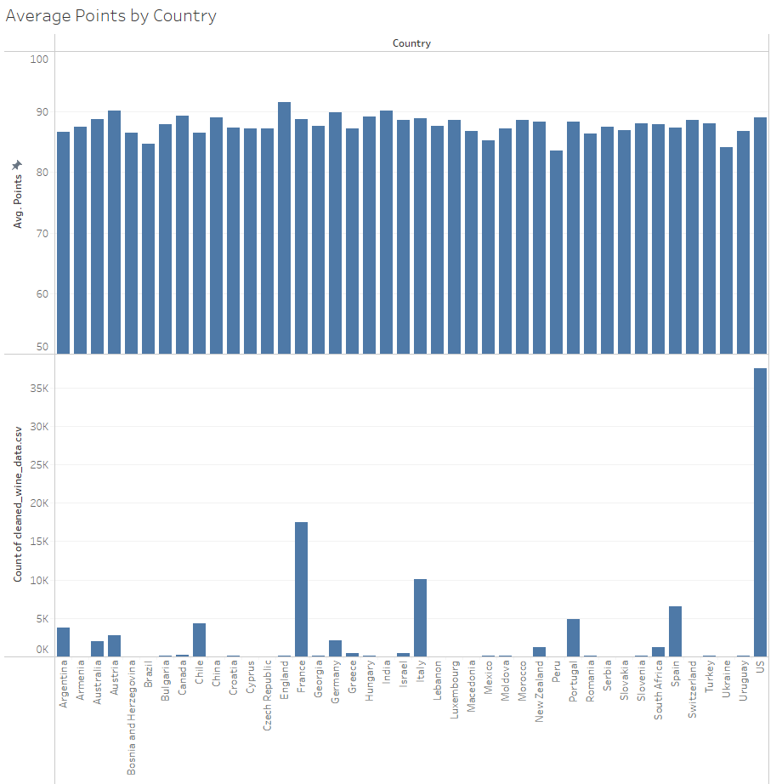
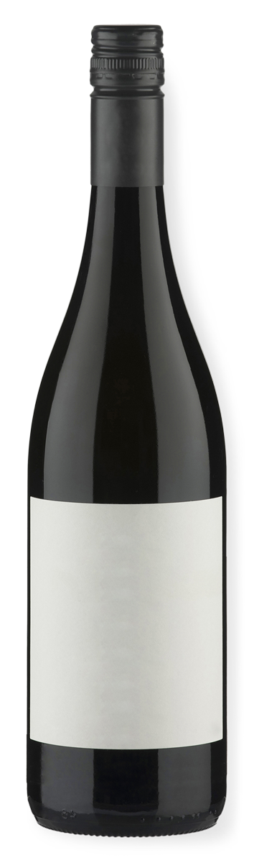
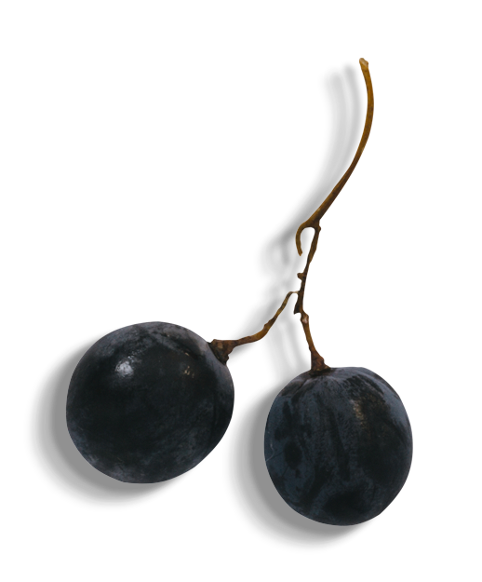
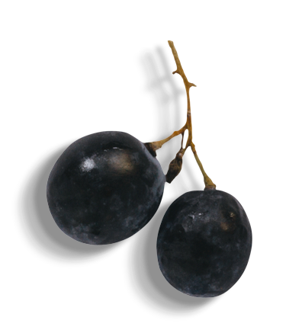
DASHBOARD
DEVELOPMENT
Notes:
notes_title
add_note_to_this_slide

Slide 7


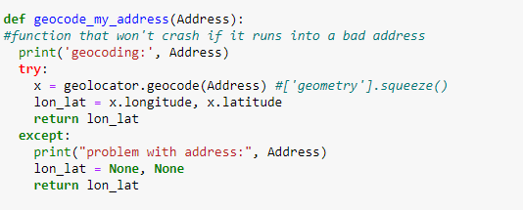


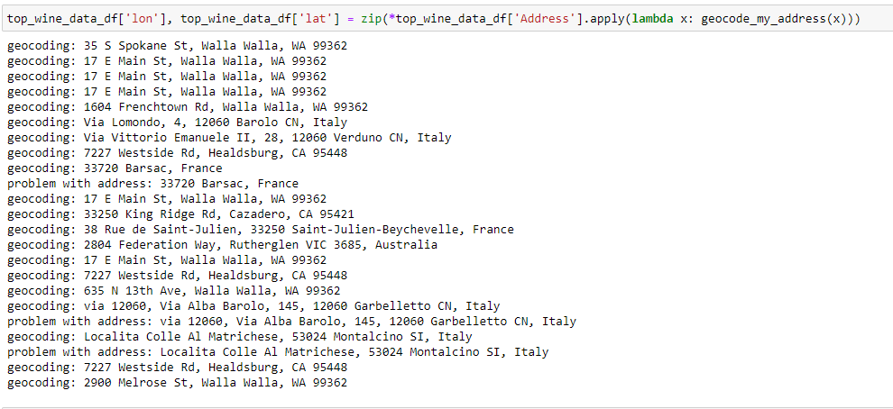
MAPPING
Manual collection of addresses for top 20 reasonably priced (<$100) wines
Added applicable columns (address, lat, long)
Lat/Long API call
Export dataframe as csv and json
Notes:
notes_title
add_note_to_this_slide

Slide 8


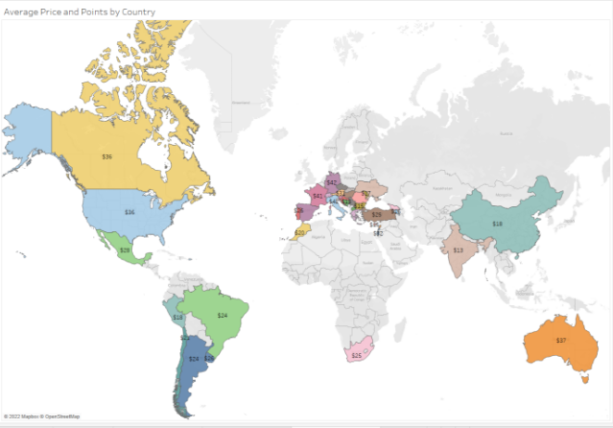
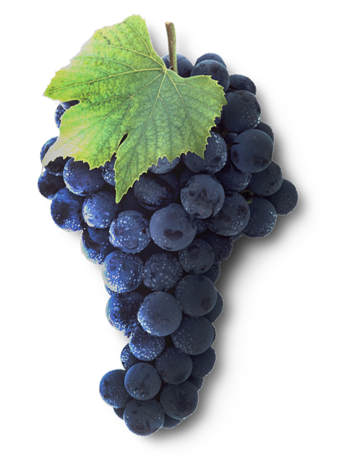
MAPPING
Utilize leaflet functionality to create map
Multiple tile layers:
Streets, satellite, dark
Multiple layer group to add interactivity/ searchability by wine quality
To be added:
Markers with wine, winery, and related information
Notes:
notes_title
add_note_to_this_slide

Slide 9


Machine Learning Model Development
1
Build multiple ML models to test
Random Forest Classifier Model
LASSO regression Model
Neural Network Optimization Model
Decision Tree Classifier
Logistic Regression Model
Utilize variety of features to predict target value of points classification, i.e.:
2
Price
Variety
Country
Descriptive Words
Notes:
notes_title
add_note_to_this_slide

Slide 10
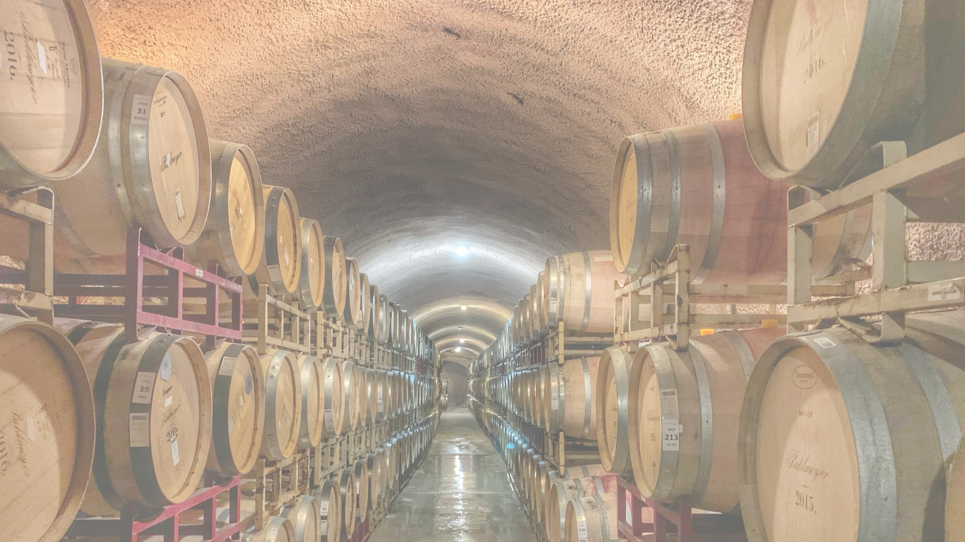
THANK YOU
Notes:
notes_title
add_note_to_this_slide

